Slide 1
Building daily CalLite model from scratch – daily version

Slide 2
Goals
Learn how to rebuild CalLite schematic North of Delta model from scratch using daily data
Including Delta operations and requirements will be saved for later
Review how WRESL routes water without actual channel routing like Muskingum method
Determine the validity and corroborate the results

Slide 3
North of Delta Daily 1-year model
Time period
August 2019-August 2020 (mostly water year 2020)
Progresses as phases and sub-phases which can be done on parallel paths
Feather River to Confluence
Yuba River to Confluence
Feather-Yuba to SacFeather confluence
Shasta to Red Bluff
Trinity to Red Bluff
Shasta-Trinity to SacFeather confluence

Slide 4
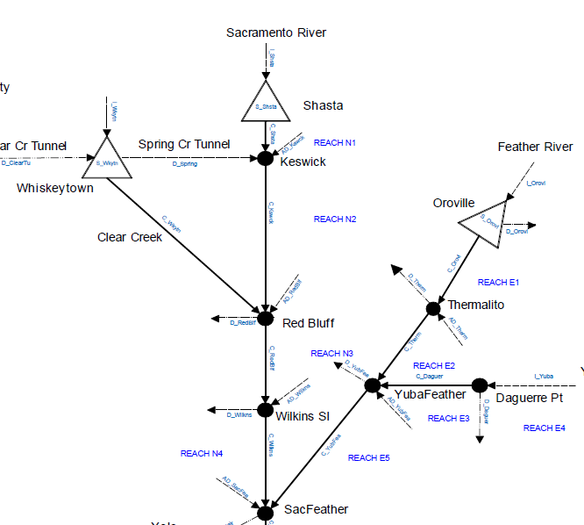
Schematic

Slide 5
Questons
What is the philosophy of using Accretion-Depletion (AD) terms?
How to estimate daily AD terms from available daily data?
Is it okay to estimate these terms using CDEC data or will I have to refer to CalSim II data?
With the

Slide 6
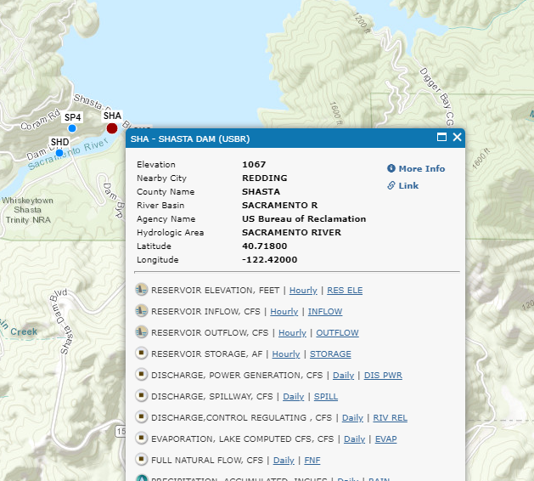
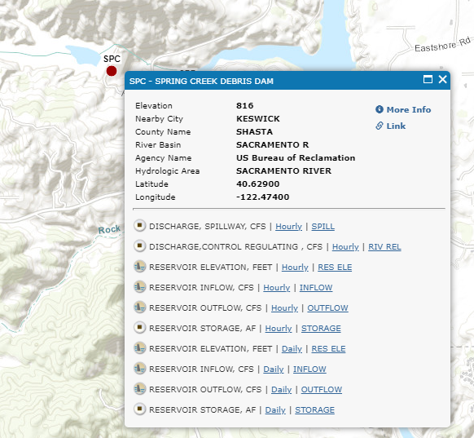
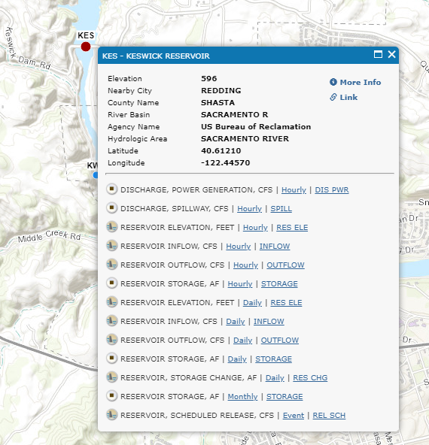
AD_KSWCK
Three components
Shasta dam (SHA) release
Inflow from Spring Creek (SPC)
Keswick dam release (KES)

Slide 7
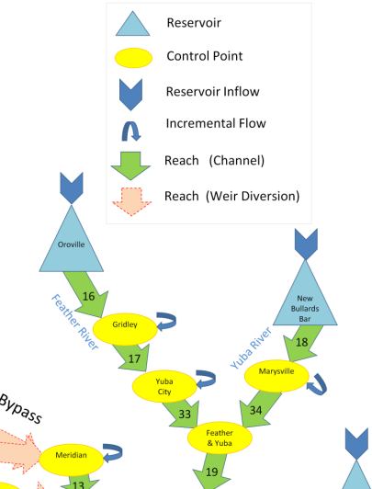
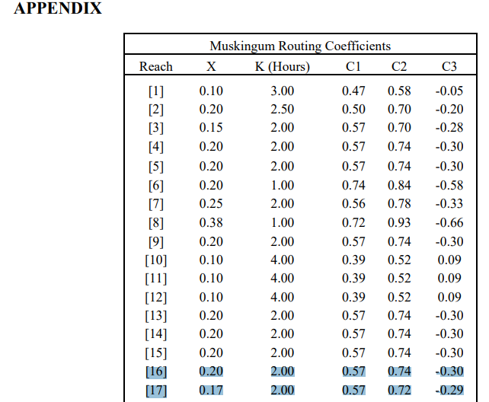
Connaughton (2014)
Sacramento Valley Integrated Reservoir Optimization Model (SVIROM): Flood Control linear program
Provided appendix with derived Muskingum routing coefficients
Reach 16 would be

Slide 8
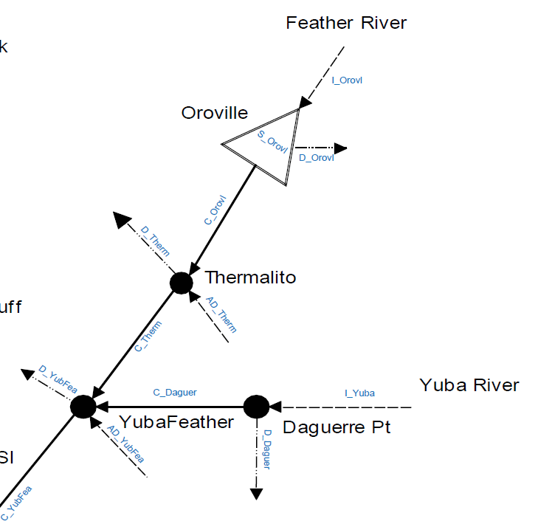
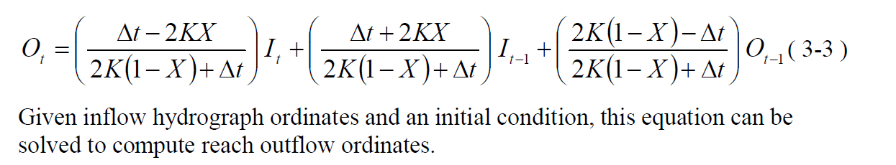
CalLite schematic
$$CTHERM=C_{0}COROVL+C_{1}COROVL\left(−1\right)+C_{2}CTHERM(−1)$$

Slide 9
Phase 1 data requirements
Lake Oroville
Inflow (TAF/day)
Initial storage
Level 5 storage
Evaporation rate
Oroville water rights demands
Minimum groundwater pumping

Slide 10
Thermalito demands and diversions
Region | Delivery Node | Project Delivery Type
Western Canal | D7A_PWR | Water rights
 | D7A_PAG | Agricultural
 | D7A_PRF | Refuge
Joint Canal | D7B_PWR | Water rights
 | D7B_PAG | Agricultural
 | D7B_PRF | Refuge
Rice decomp | D7C
Butte County | D201_PIMI | Indoor M&I
 | D201_POMI | Outdoor M&I
Thermalito Irrigation District | D202_PWR | Water rights

Slide 11
Extra slides

Slide 12
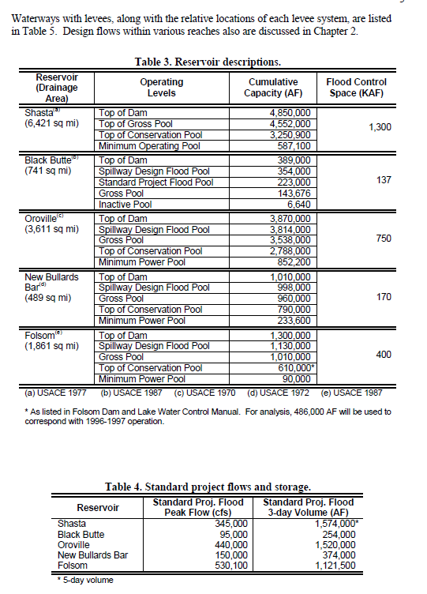
Dustin Jones’ thesis

Slide 13
Reservoir Operation (Jones 1997)
Oroville Dam. Oroville Dam is operated to prevent flows on the Feather River from exceeding 150,000 cfs at Oroville, 180,000 cfs above and 300,000 cfs below the mouth of the Yuba River, and 320,000 cfs below the mouth of the Bear River. Oroville Dam releases should not be increased by more than 10,000 cfs or decreased by more than 5,000 cfs during any 2-hour period. The National Weather Service in Sacramento provides 24-hour forecasts twice a day. From January through May, the National Weather Service also publishes water supply forecasts indicating the forecasted volume of runoff for the remainder of the water year (USACE, 1970).
New Bullards Bar. New Bullards Bar reservoir is operated so as not to cause flow in the Yuba River at Marysville to exceed 120,000 cfs (180,000 cfs when flow in the Feather River is low). The dam also is operated to keep flow in the Feather River below the Yuba River confluence from exceeding 300,000 cfs and below the Bear River confluence from exceeding 320,000 cfs. Releases at New Bullards Bar Dam should not be increased or decreased by more than 5,000 cfs in any 1-hour period (USACE, 1972).

Slide 14
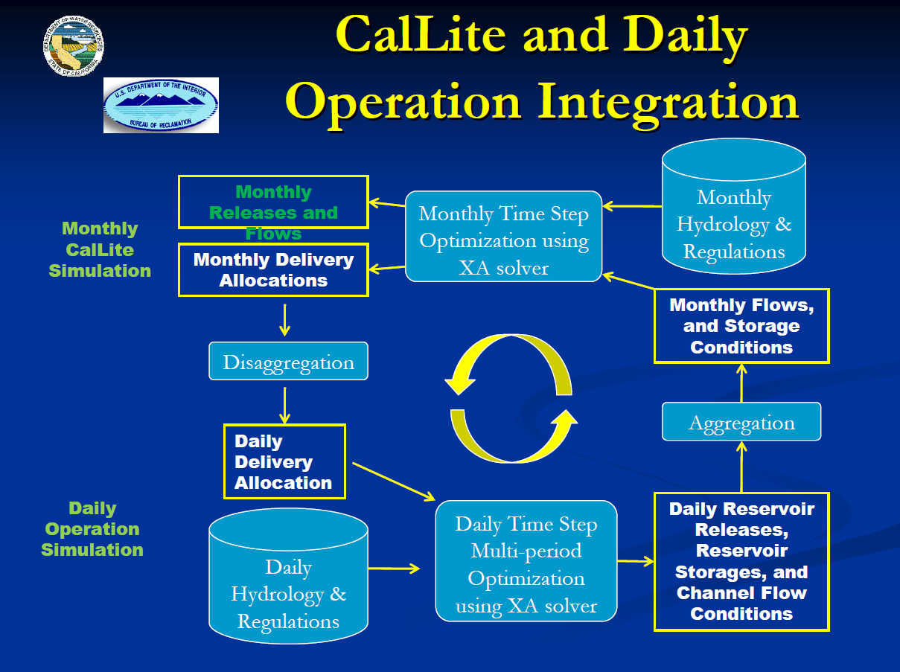

Slide 15
